Slide 1
Machine Learning A-Z™: Hands-On Python & R In Data Science
Decision Trees and Random Forests
June 21, 2019
Ariel Capetillo
Juan Carlos Urrutia

Slide 2
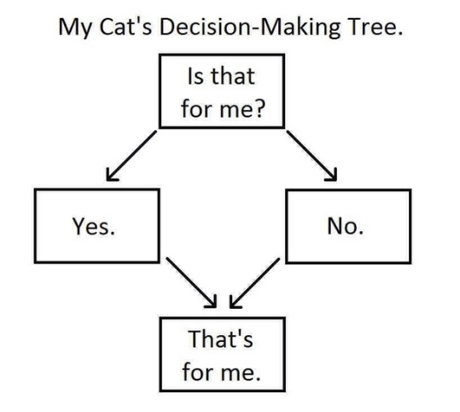

Contents
01 |  | Introduction to Decision Trees (DT)
02 |  | DT in Python
03 |  | DT in R
04 |  | DT Quiz
05 |  | Introduction to Random Forests
06 |  | RF in Python
07 |  | RF in R
08 |  | RF Quiz
09 |  | Model Selection
Notes:
Ask: Who watched this week videos?

Slide 3
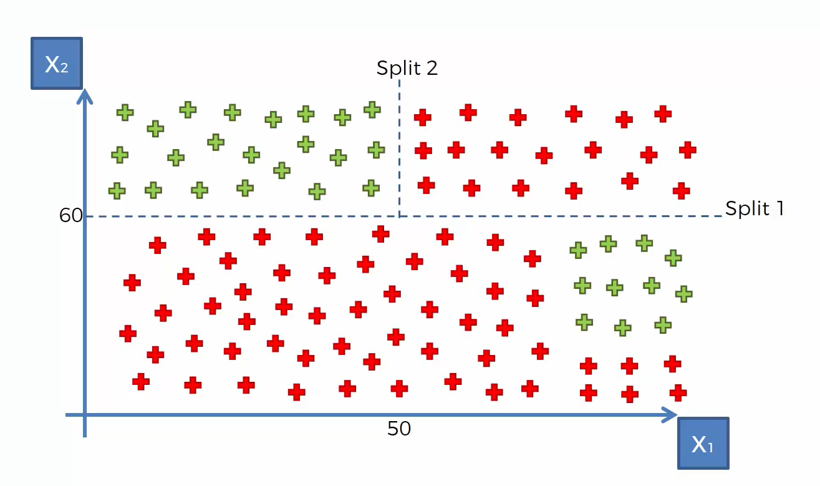
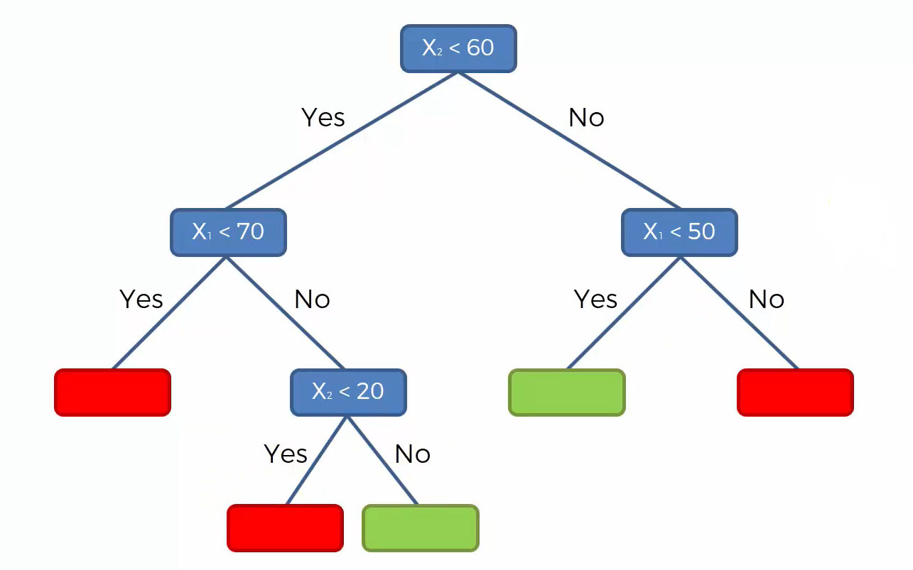
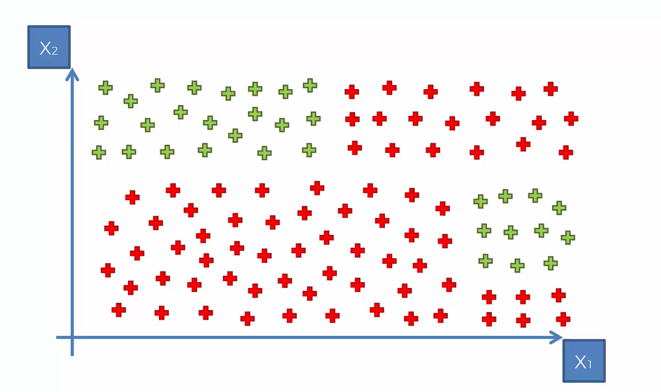
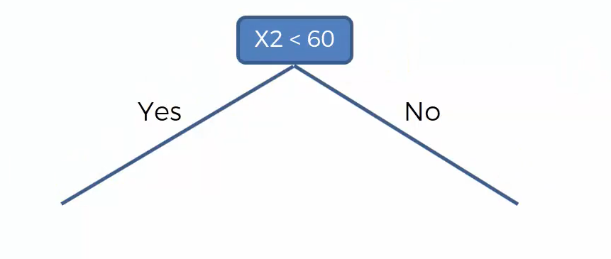
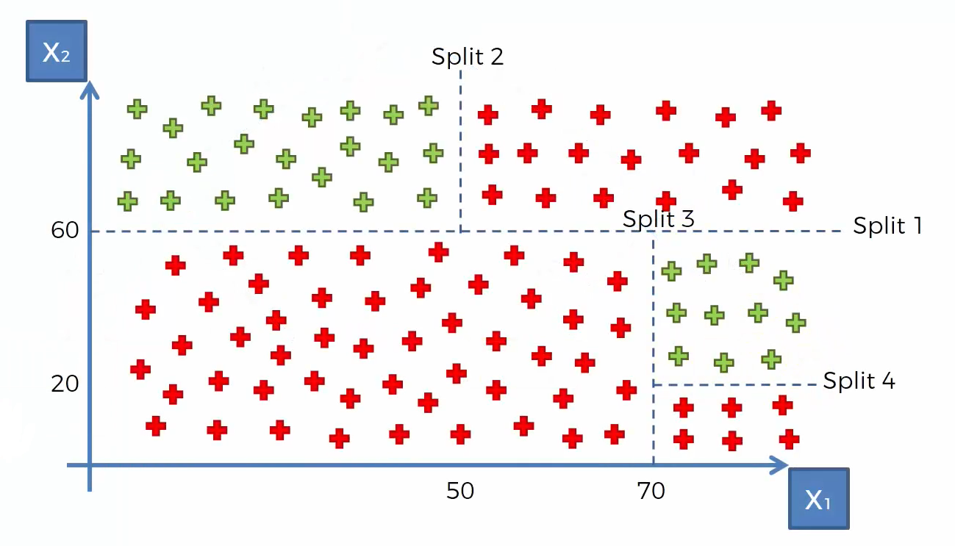
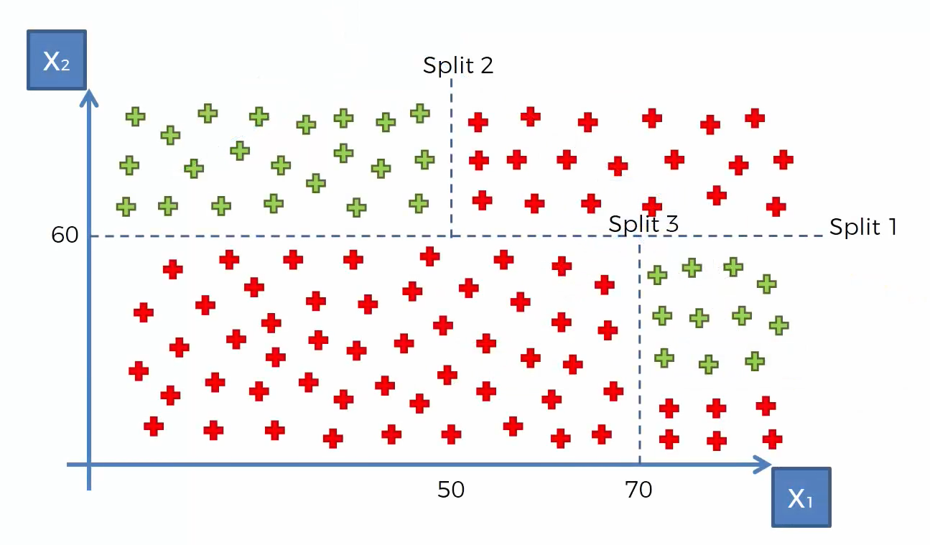
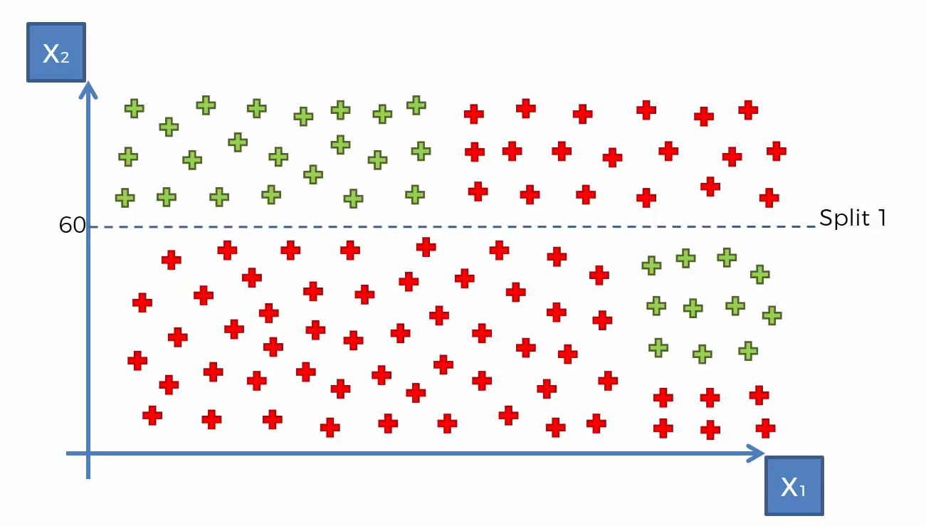
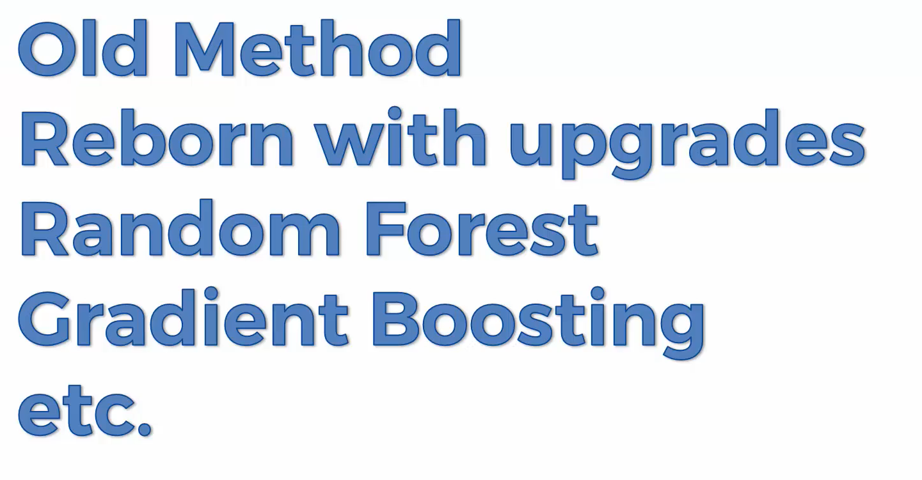
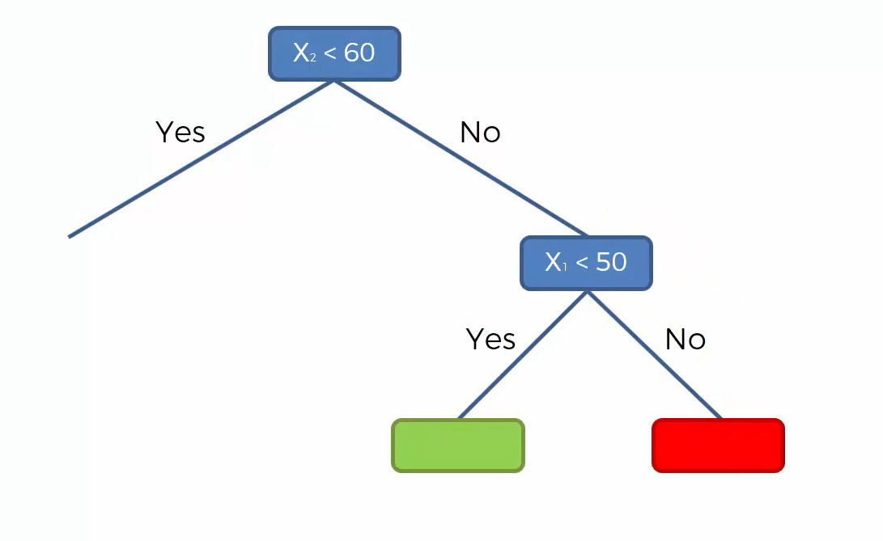
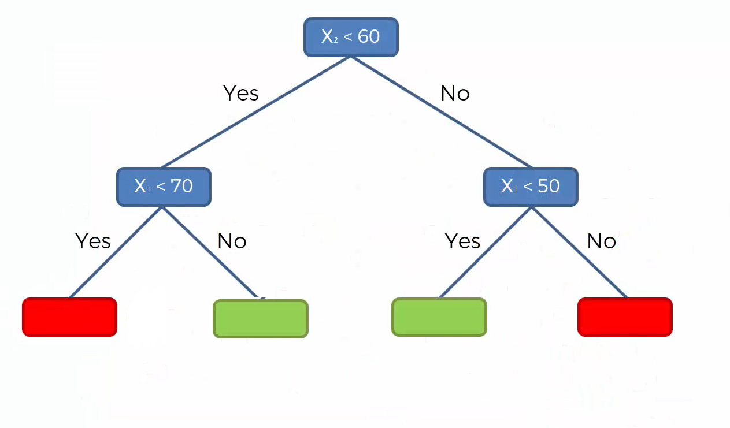
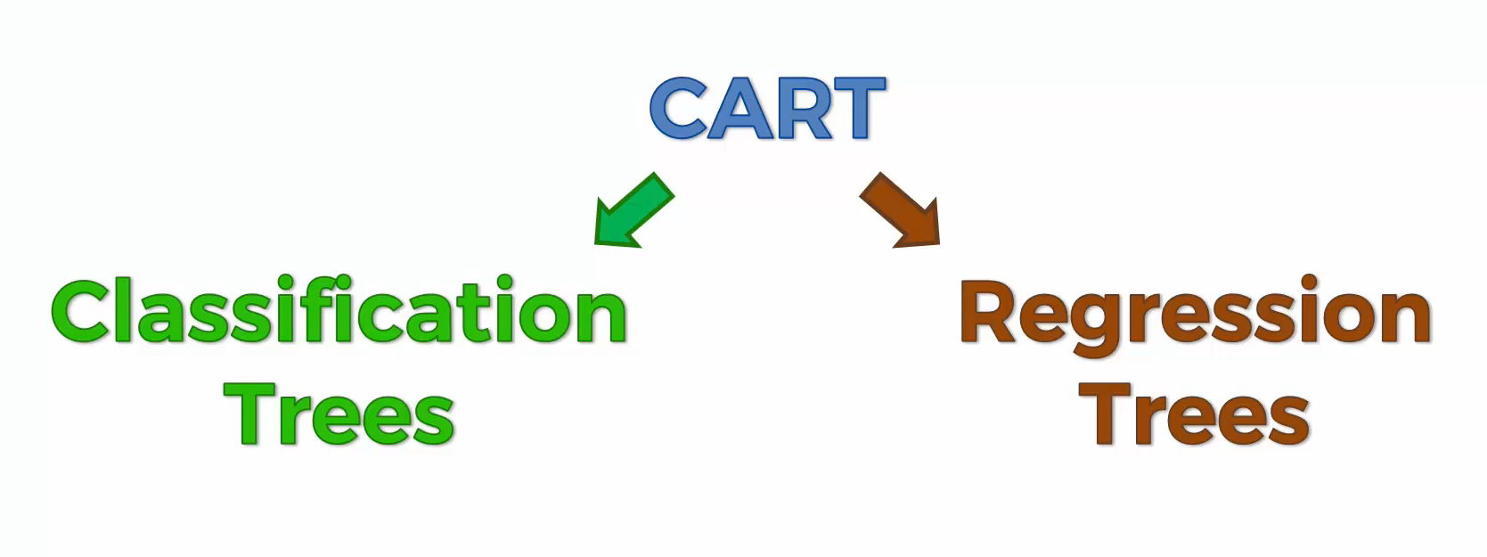
Decision Trees
The splits pretend to minimize entropy. What does that mean?
Often interpreted as the degree of disorder or randomness in the system.

Slide 4
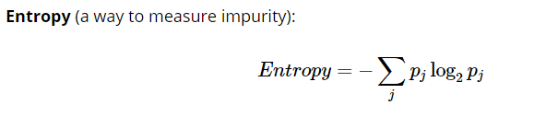
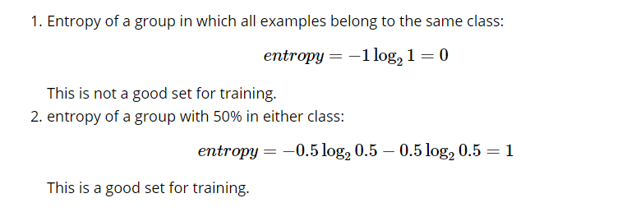
Useful Concepts for DT (and RF)
So, basically, entropy attempts to maximize the mutual information (by constructing a equal probability node) in the decision tree

Slide 5
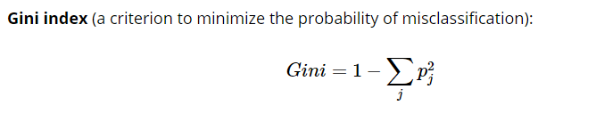
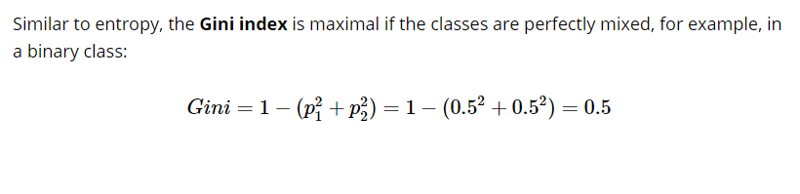
Useful Concepts for DT (and RF)

Slide 6
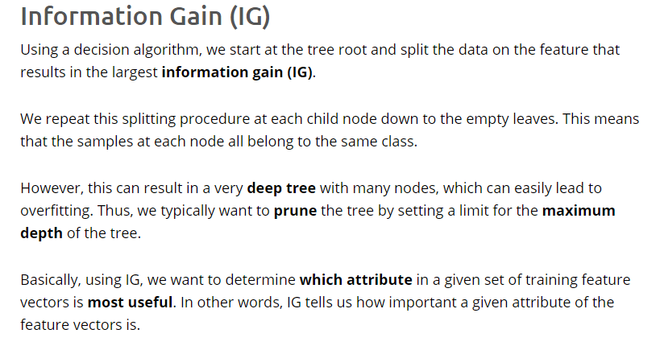
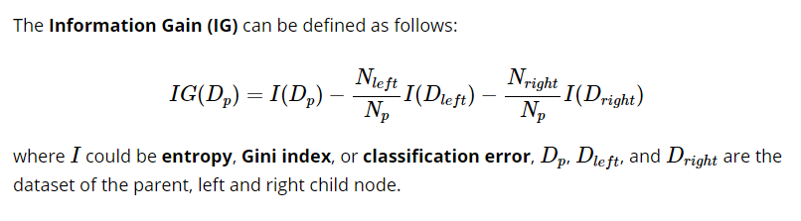
Useful Concepts for DT (and RF)

Slide 7
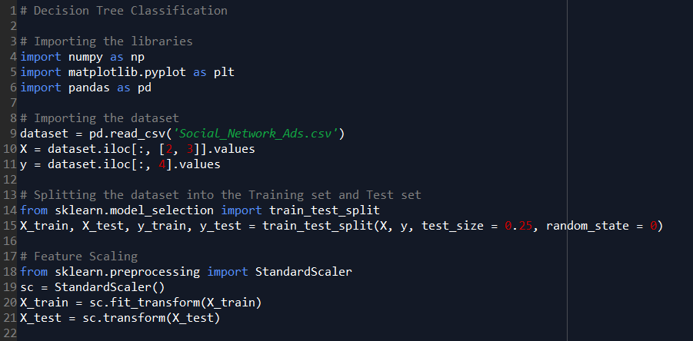
Decision Trees in Python

Slide 8
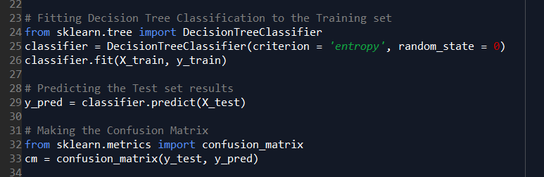
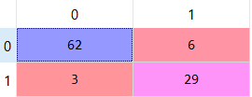
Decision Trees in Python
Accuracy?
Error Rate?
Positive Predicted Value?
Sensitivity?
Negative Predicted Value?
Specificity?

Slide 9
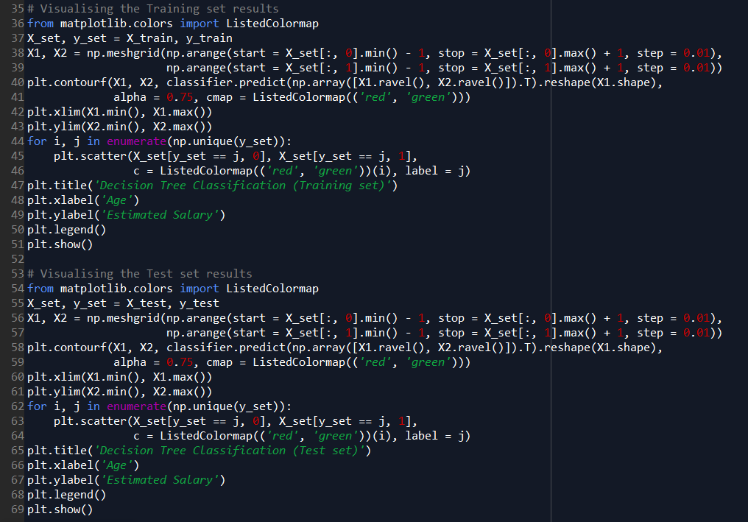
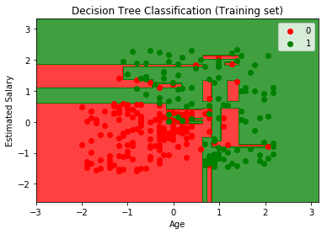
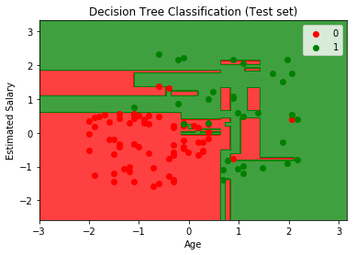
Decision Trees in Python

Slide 10
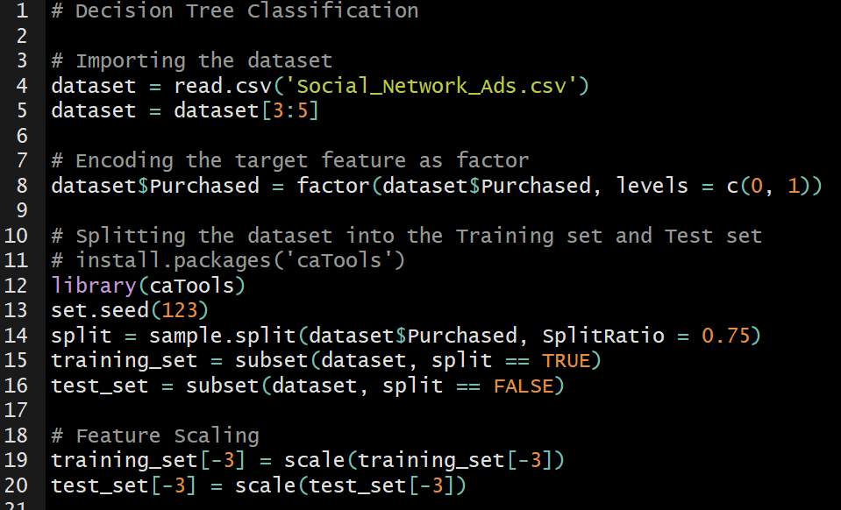
Decision Trees in R

Slide 11
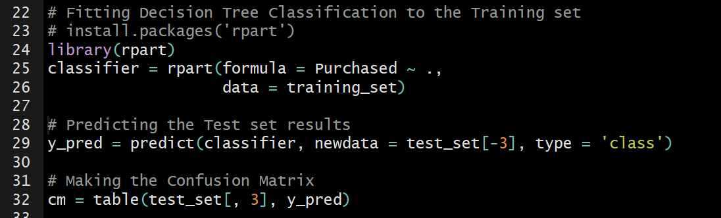
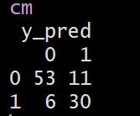
Decision Trees in R
Accuracy?
Error Rate?
Positive Predicted Value?
Sensitivity?
Negative Predicted Value?
Specificity?

Slide 12
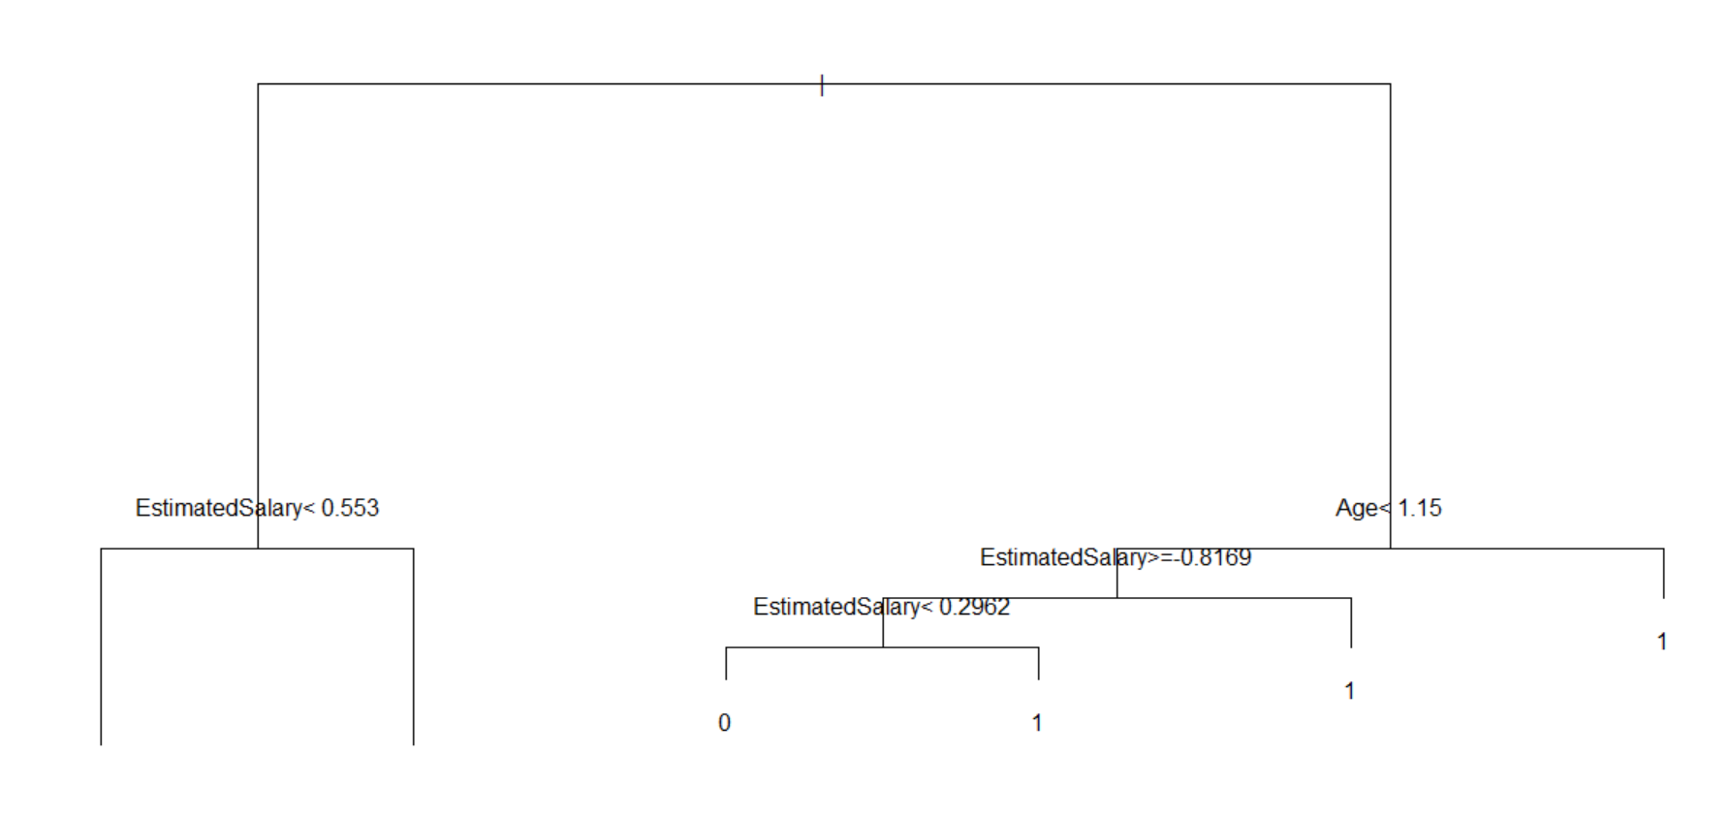
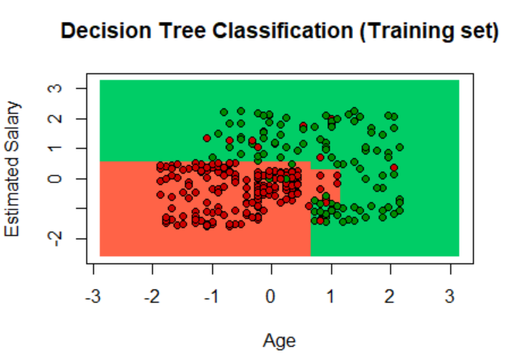
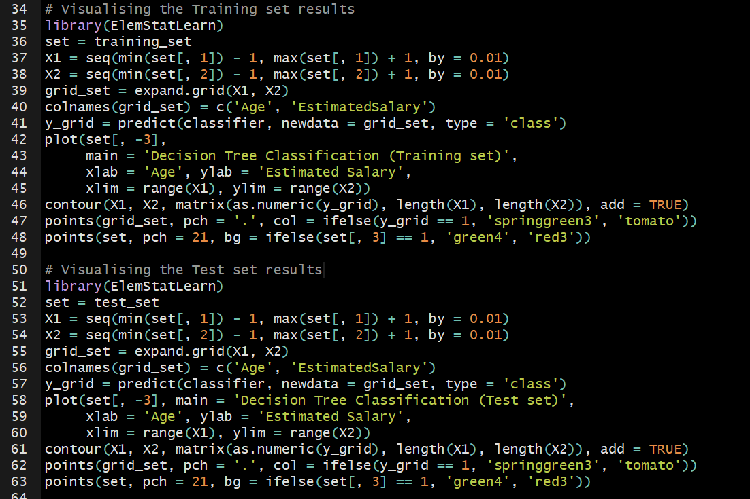
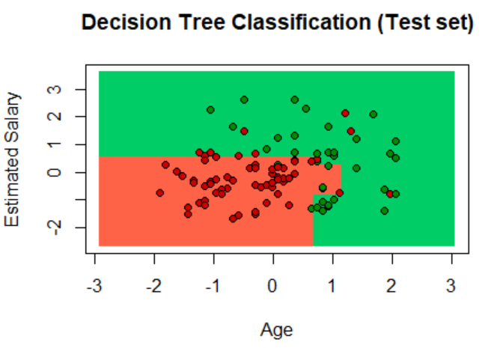
Decision Trees in R

Slide 13
Decision Trees Quiz
Let’s do a Quick Quiz
About Decision Trees

Slide 14

Random Forest
1
Pick at random K data points from the training set
Random Forests, in average, can perform very well, leveraging the power of the crowd
2
Build the decision tree associated to these K data points
3
Choose the number of trees that you want to build and repeat steps 1 and 2.
4
For a new data point, make every tree predict the category to which the data point belongs, and assign the new data point to the category that wins the majority vote

Slide 15
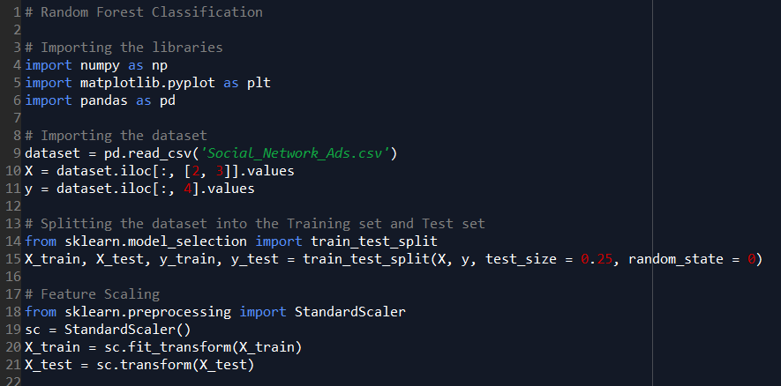
Random Forest in Python

Slide 16
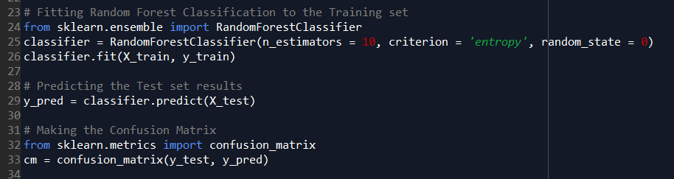
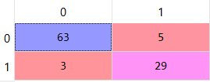
Random Forest in Python
Is it better or worst than the Decision Tree?

Slide 17
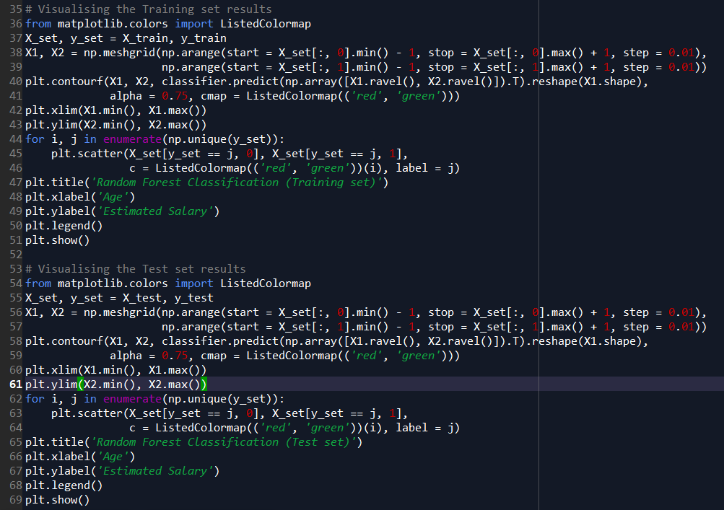
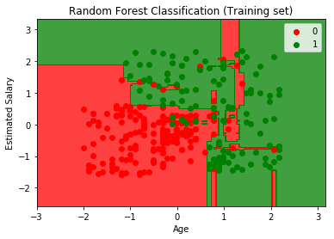
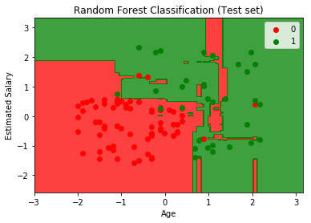
Random Forests in Python

Slide 18
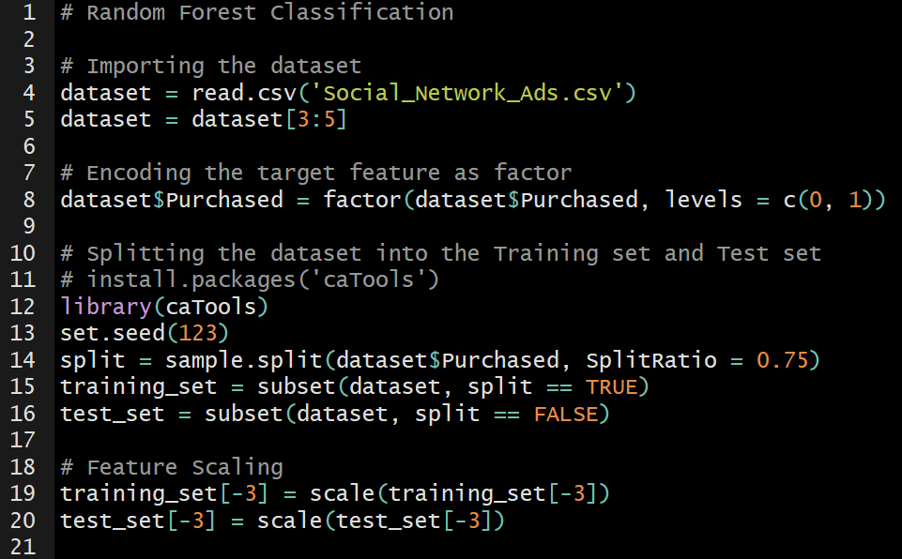
Random Forest in R

Slide 19
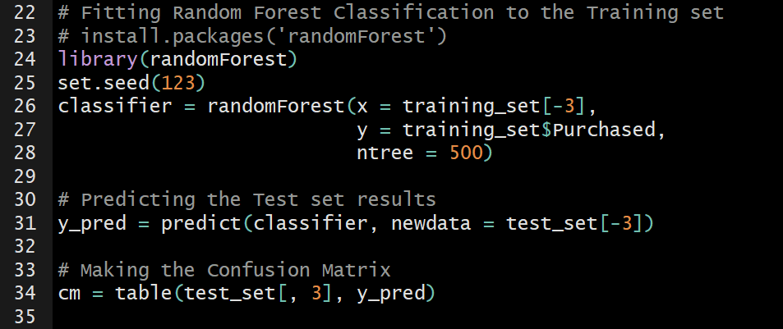
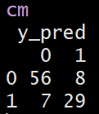
Random Forest in R
Is it better or worst than the Decision Tree?
The best model was built in Python or R?

Slide 20
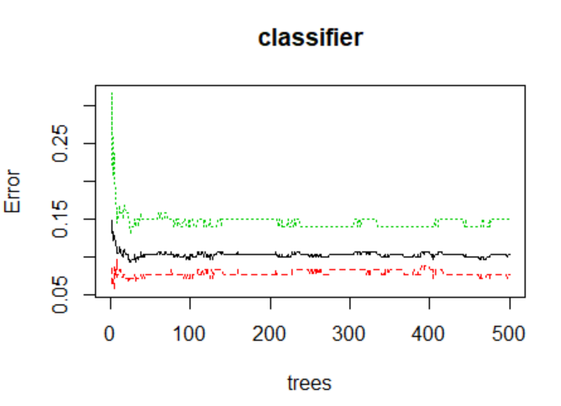
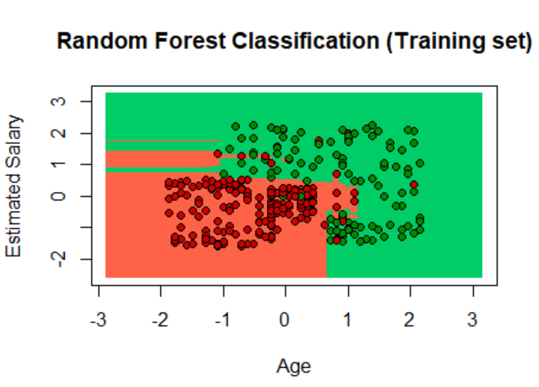
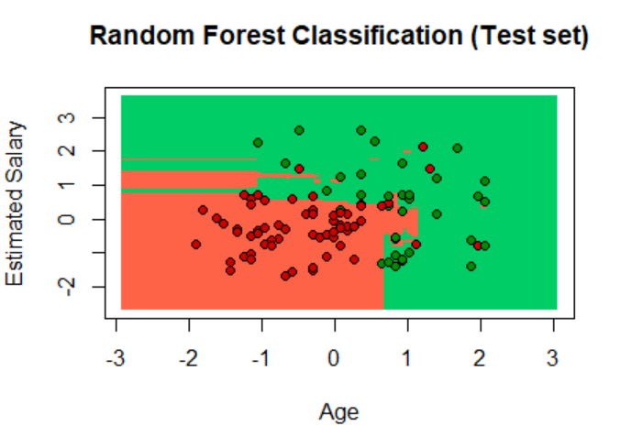
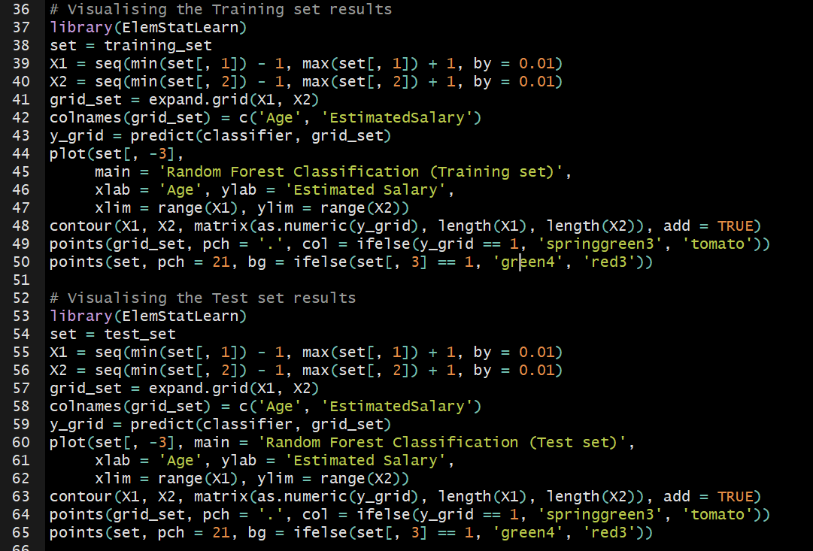
Random Forest in R

Slide 21
Random Forest Quiz
Let’s do a Quick Quiz
About Random Forests

Slide 22
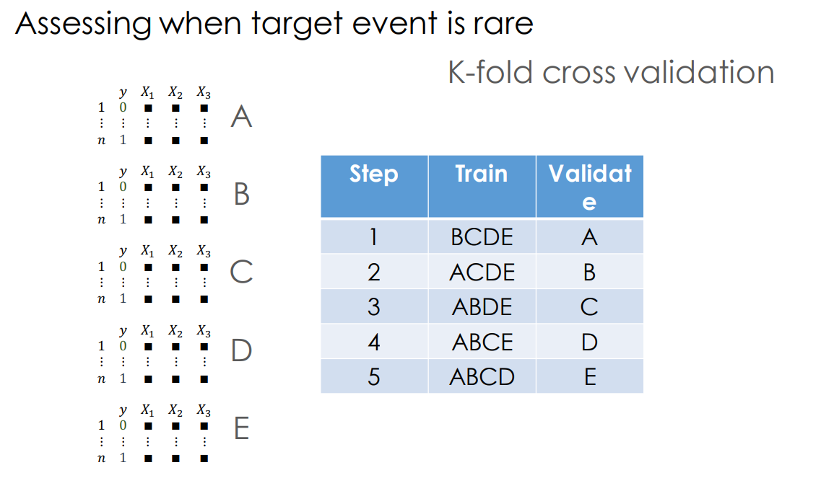
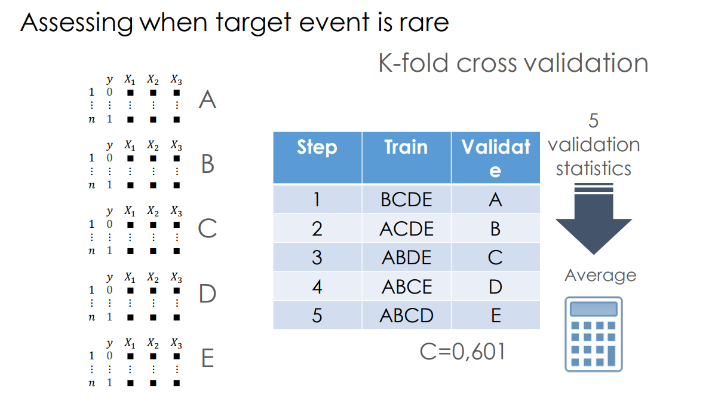
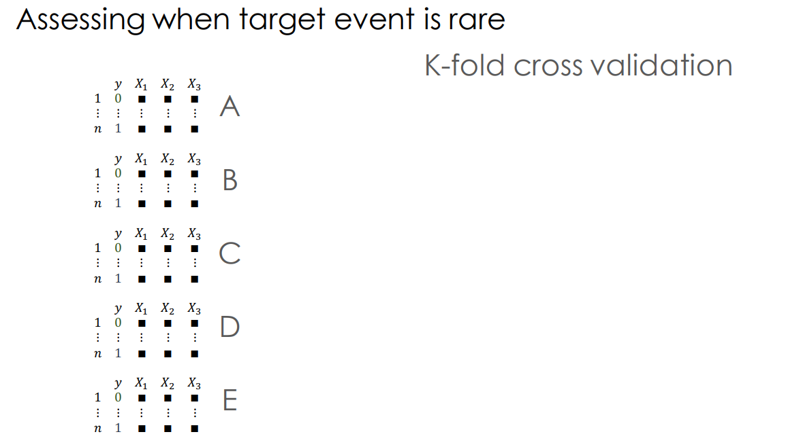
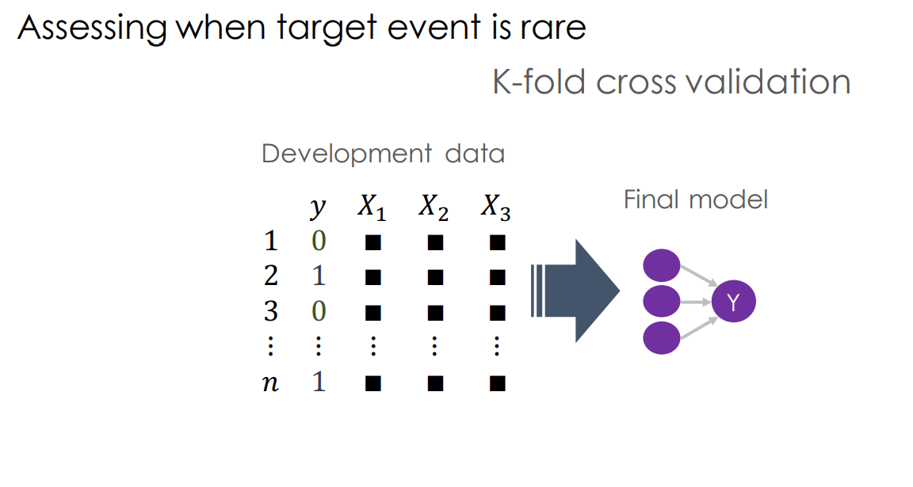
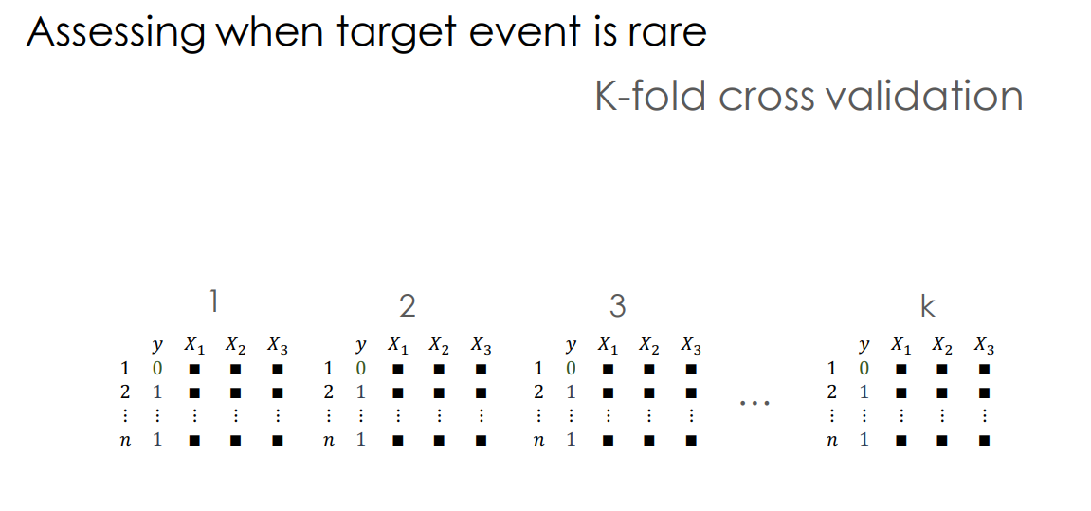
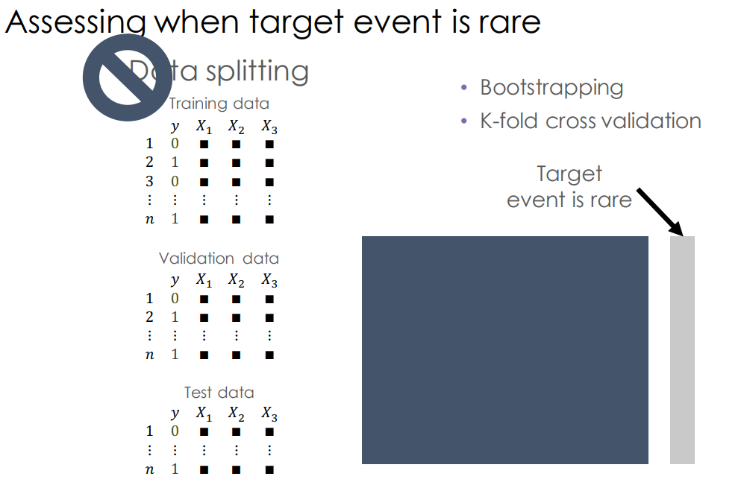
Model Selection
K-Fold

Slide 23
Model Selection
Grid Search
Let’s see how we can work around
hyperparameter tuning (and K-fold)

Slide 24

Next Session:
Clustering
Thanks! Let’s make the complex simple…

Slide 25

Enjoy Machine Learning
;)

